Slide 1
TURING MACHINE VS PUSHDOWN AUTOMATA
GROUP MEMBERS:-
Himanshu pandey(20)
Bharagav pawar(46)
Nishant bhat(41)
AbhiJiT gawai(18)
Shyam kawale(27)

Slide 2
TURING MACHINE
Definition
Turing machine is a 5 tuple machine. A Turing machine is a mathematical model of computation that defines an abstract machine a which manipulates symbols on a strip of tape according to a table of rules. Despite it’s simplicity ,turing machine can be adapted to stimulate the logic of any computer algorithm.

Slide 3
REPRESENTATION OF TURING MACHINE
Turing machine is represented by
T= (Q, T, ∑, δ, q0)
Q is a finite, non-empty set of states;
T is a finite, non-empty set of tape alphabet symbols;
∑ is the set of input symbols, that is, the set of symbols allowed to appear in the initial tape contents;
q0 is the initial state.
δ is a partial function called the transition function.

Slide 4
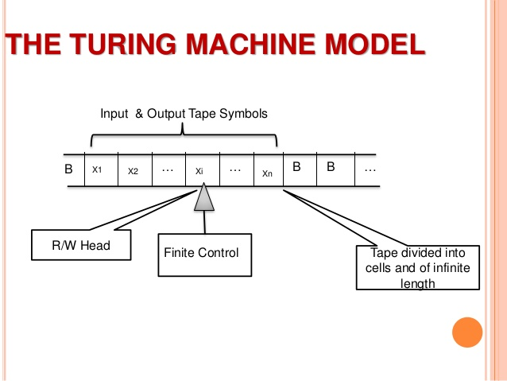

Slide 5
TRANSITION FUNCTION
One move in a Turing machine does the following:-
δ(q,X)=(p,Y,R/L)
q is the current state
X is the current tape element pointed by tape head
State changes from q to p.

Slide 6
APPLICATIONS OF TURING
MACHINE

Slide 7
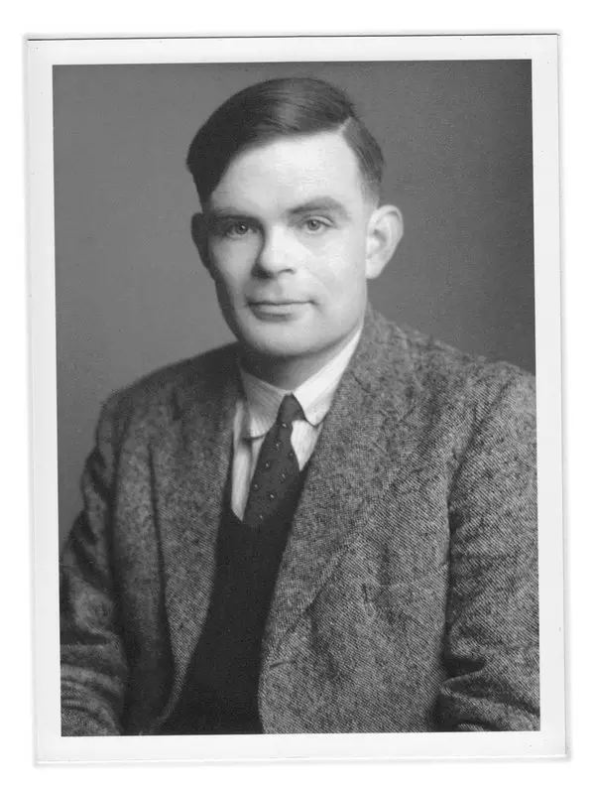
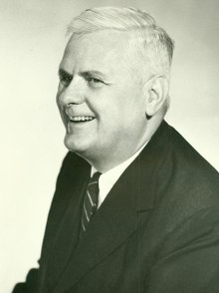
CHURCH TURING THESIS
Alonzo Church
Allan Turing

Slide 8
Several Variations of TM:
One tapes or many
Infinite on both ends
Alphabets only {0,1} or more
Can the head also stay in the same place
All variations are equivalent in computing ability

Slide 9
Universal Turing Machine
The language:
A ={< M, w >| M is a turing machine that accepts w}
is turing recognizable.
M accepts w : Our algorithm will halt and accept
M rejects w : Our algorithm will halt and reject
M loops on w : Will not halt

Slide 10
PDA
PDA stands for Push-Down Automata.
Pushdown Automata is a finite automata with extra memory called stack which helps Pushdown automata to recognize Context Free Languages.
Grammar type –TYPE-2
Concept of Pushdown acceptor were first formalized by Chomsky and Evey, although the notion of a Pushdown tape has been used since 1954

Slide 11
PDA
STACK-Stack is a linear data structure which follows a particular order in which the operations are performed(LIFO).
Operations performed on stack:
1)Push
2)Pop
This machine is more capable of than finite state machines but less capable than Turing Machine in terms of computation by machines.
Deterministic Pushdown Automata can recognize all deterministic context free language while non-deterministic ones can recognize all context free languages

Slide 12
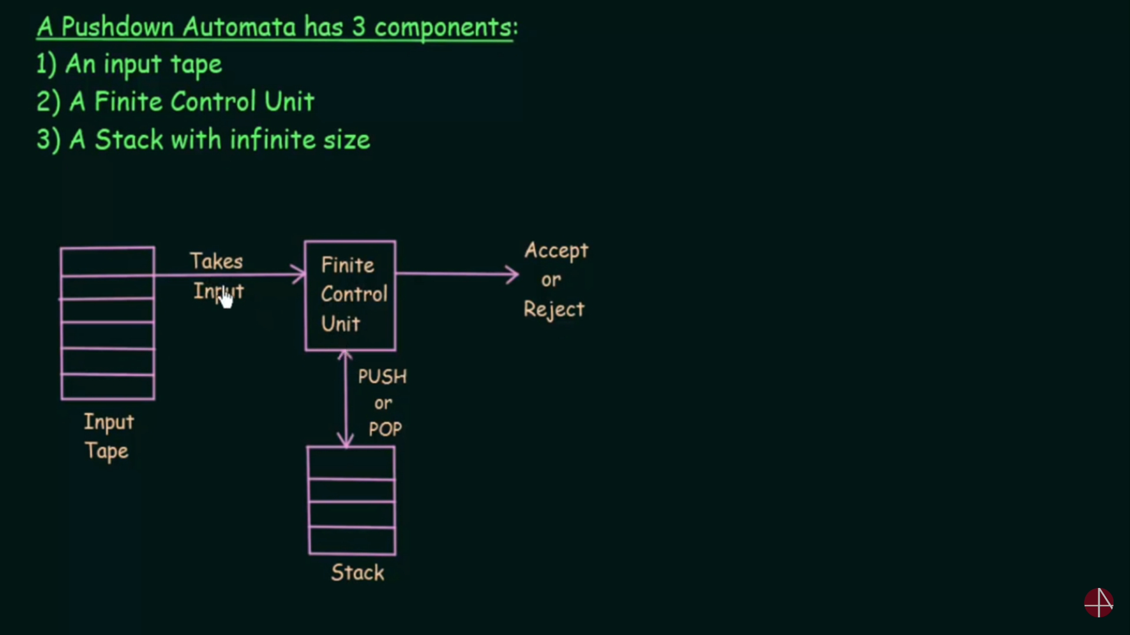
Working of PDA:

Slide 13
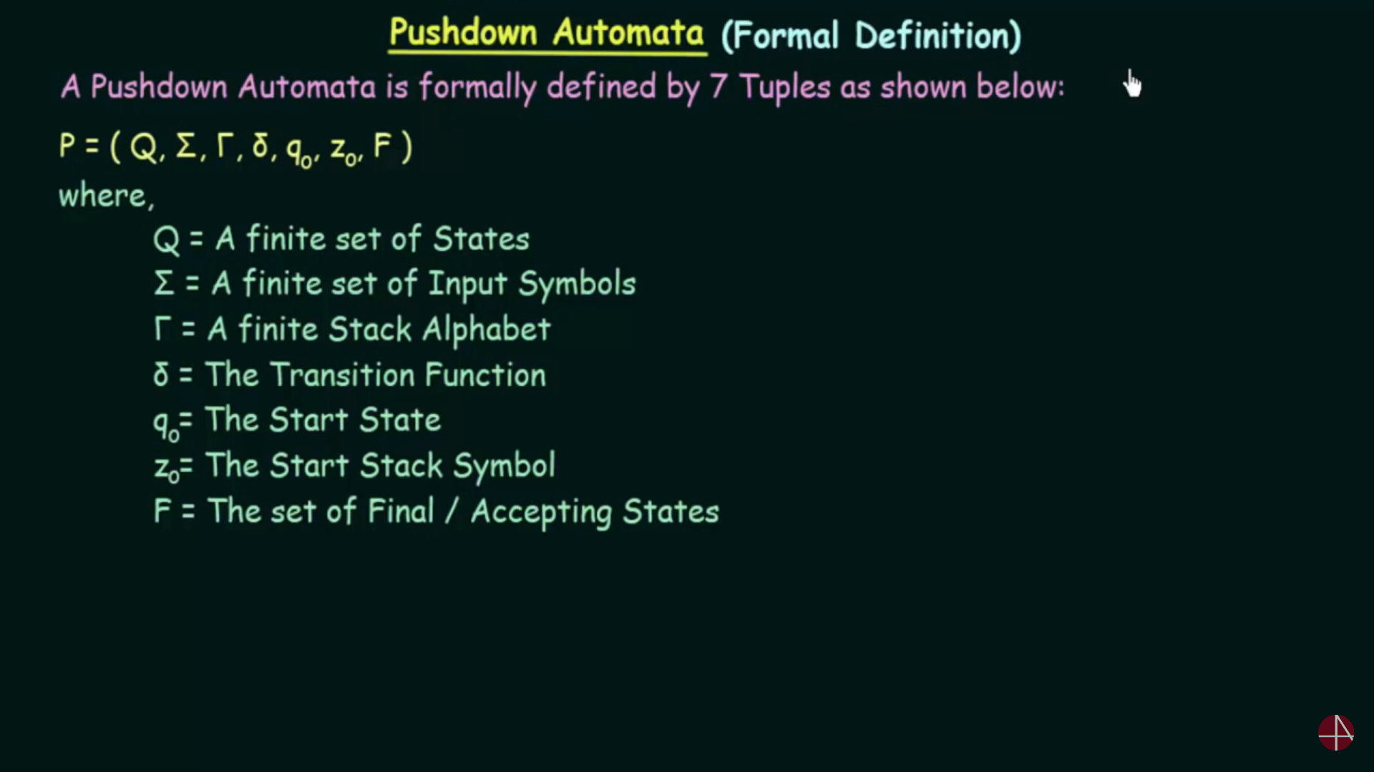
Formal Defination of PDA:

Slide 14
Transition Function:
Transition function in a PDA can be written as :
Ᵹ(q,a,x)=PY
Where q is state in Q.
a is input alphabet.
x is stack alphabet
P is new state.
Y is stack alphabet that will replace X.

Slide 15
APPLICATION OF PUSHDOWN AUTOMATA
In calculation taking care of priority of operands is very important.
Bracket balancing is one of the application of pushdown automata.
Pushdown automata is used in non-programmable calculators, where there is no deployment of programs.

Slide 16
Move in PDA:
Where A,B are two states.
a is input alphabet that we are reading.
b is element that is to be popped.
c is the element that is to be pushed into stack.
a,b=>c
A
B

Slide 17
ALGORITHM
Insert the z0 value in the stack if stack is empty.
Traverse the string one by one.
If any opening bracket comes just push it in the stack and pop nothing.
If ‘)’ comes pop ’(’ and push ’^’.
If ‘}’ comes pop ’{’ and push ’^’.
If ‘]’ comes pop ’[’ and push ’^’.
Now if the stack contains z0 then pop z0 and push ‘^’.
You have reached the ‘ha’.

Slide 18
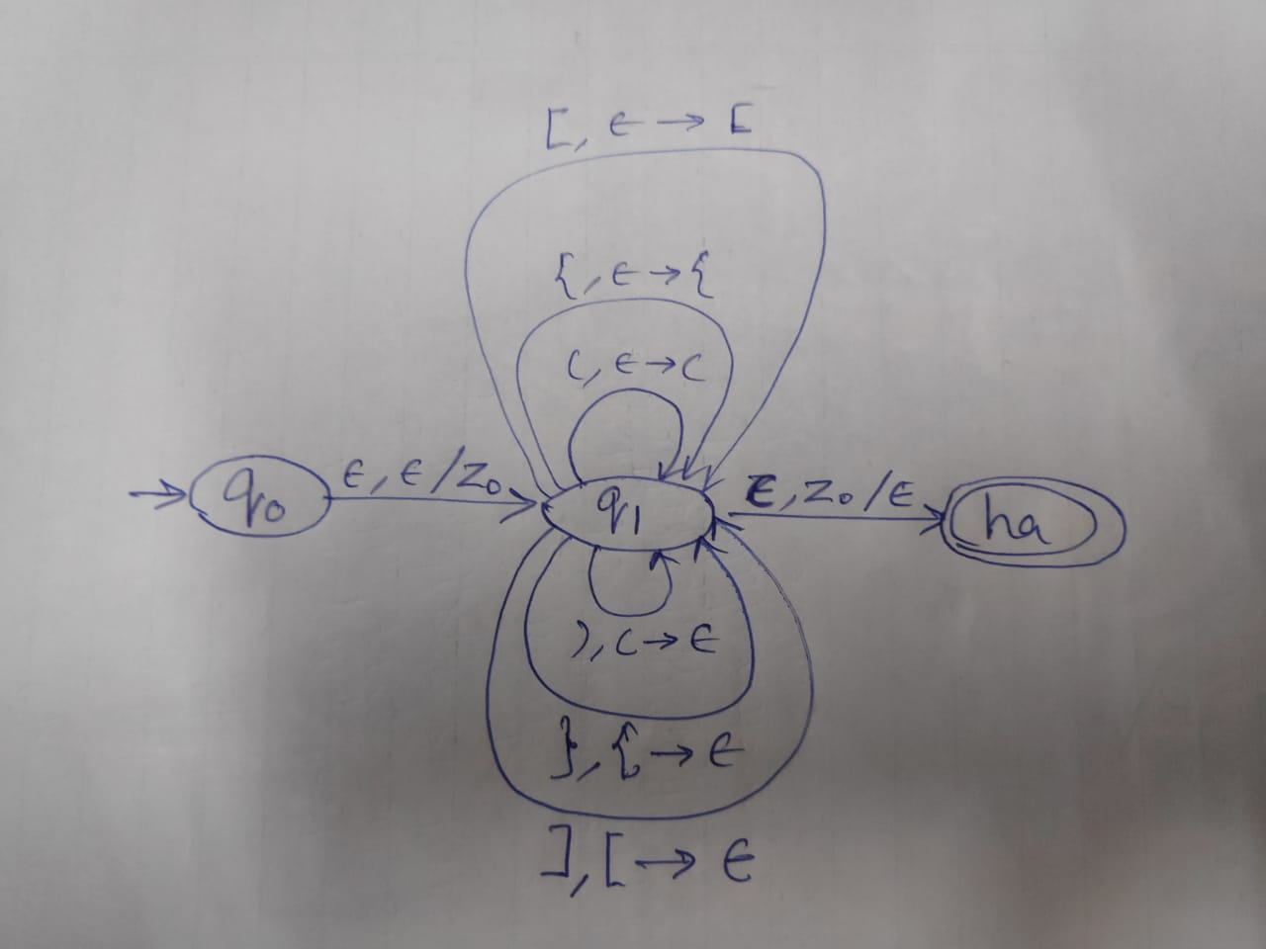
MODEL OF PDA

Slide 19
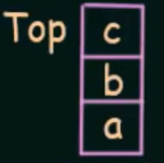
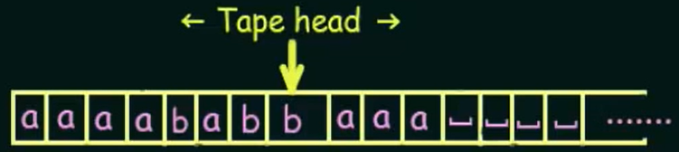
Turing machine and Pushdown Automaton
Turing machine
PDA
Grammar type – TYPE-0
Grammar Accepted –Unrestricted Grammar
Language Accepted –
Recursive Enumerable Language
Data Structure – Tape
Grammar type – TYPE-2
Grammar Accepted – Context free Grammar
Language Accepted –
Context free Grammar
Uses Stack
Data Structure - Stack

Slide 20


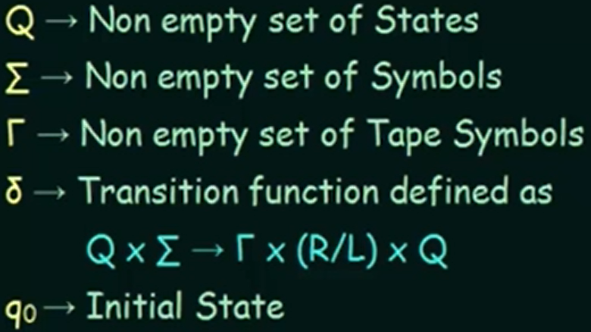
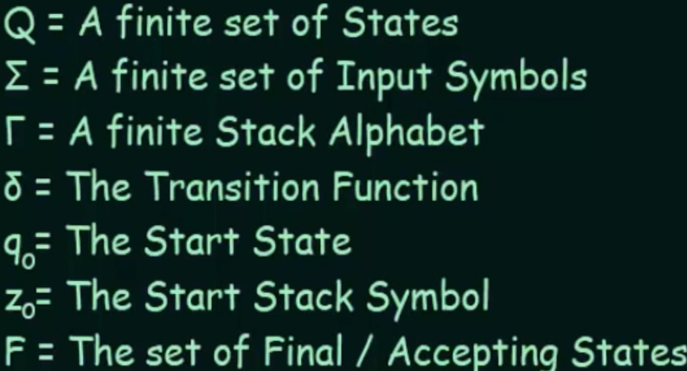

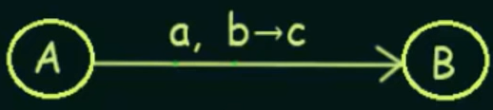
Turing machine and Pushdown Automaton
Turing machine
PDA
Formal Defination –
Defined by 5 tuples
T=
Graphical Definiation -
Formal Defination –
Defined by 7 tuples
Graphical Definiation -

Slide 21

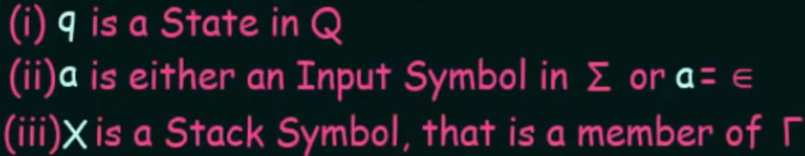


Turing machine and Pushdown Automata
PDA
Turing machine
Arguments
Transistion function takes Takes 2 arugments
Output
Set of Pairs
D is direction either left or right
Arguments
Transistion function takes Takes 3 arugments
Output
Set of Pairs

